Slide 1
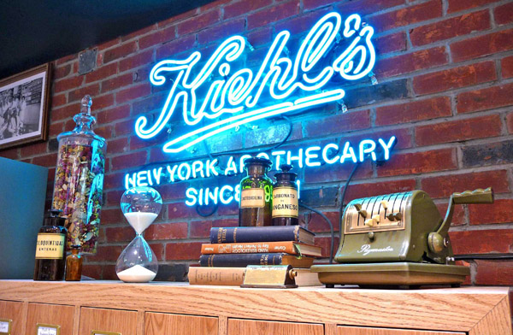

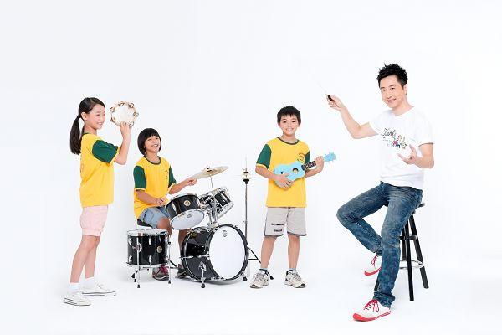

Our Mission
will
Maximize Charity Exposure
Having these less fortunate children experience the beauty of music, and the joy of being cared for.
Giving them the attention they deserve and spreading this good cause.

Slide 2
Utilizing our only source- Own Media (SLPR)
START
Observation and monitoring
Understanding client needs
Trend Analysis
Keywords Selection
Keywords determined
Content Optimization
Content Review
Revise Content
Content Expose
Ensure Content
Done by iProspect
Done by Kiehls

Slide 3
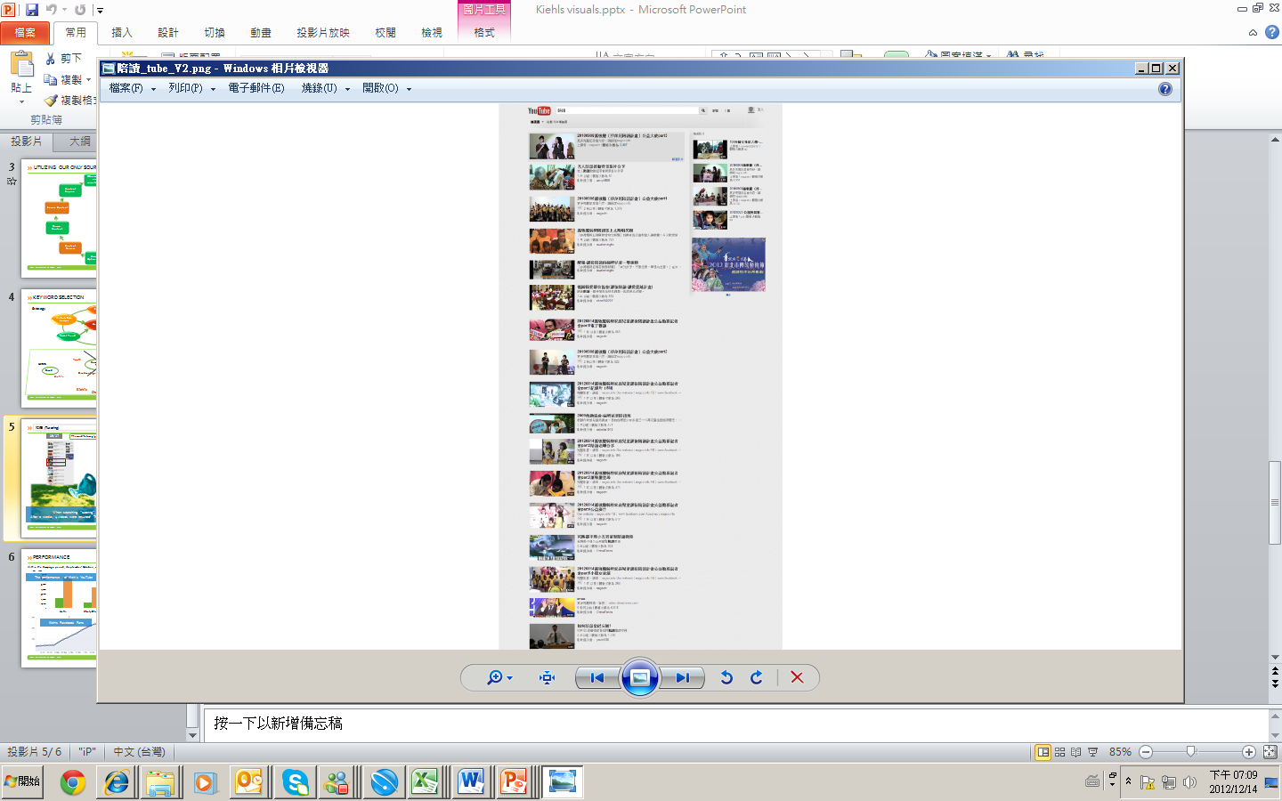
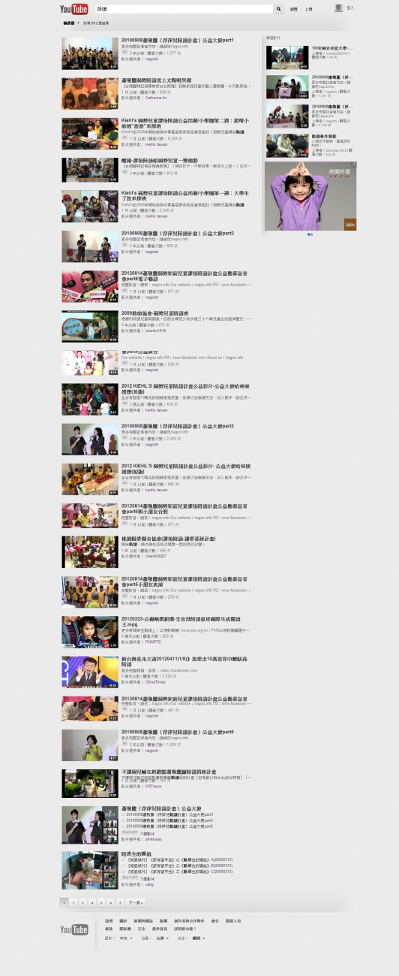
陪讀
陪讀 (Tutoring)
Before
The word “tutoring” gave the best result.
After
After 2 weeks
When searching “tutoring”, no optimized videos were resulted,
After 2 weeks, 4 videos were resulted! This demonstrates consumers’ interests increasing.

Slide 4
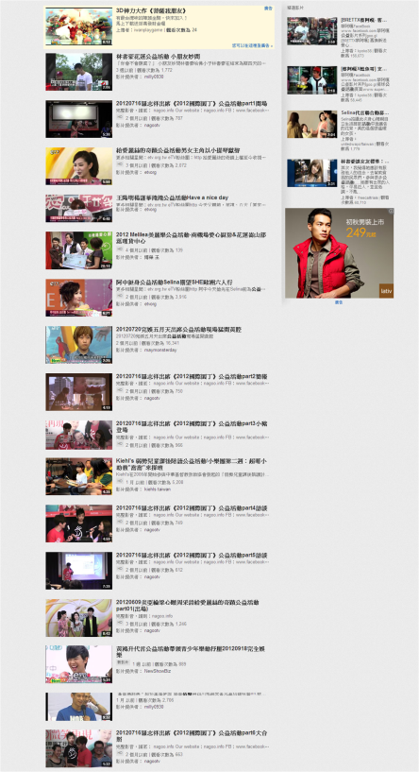
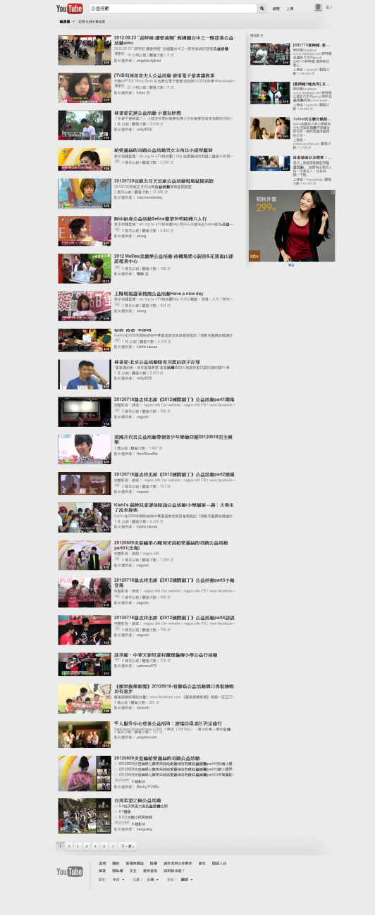
陪讀
公益活動(charity)
Before
The word “charity” gave outstanding results.
After
After 2 weeks
When searching “charity”, no optimized videos were resulted,
After 2 weeks, 2 videos were resulted! This demonstrates greater exposure.

Slide 5
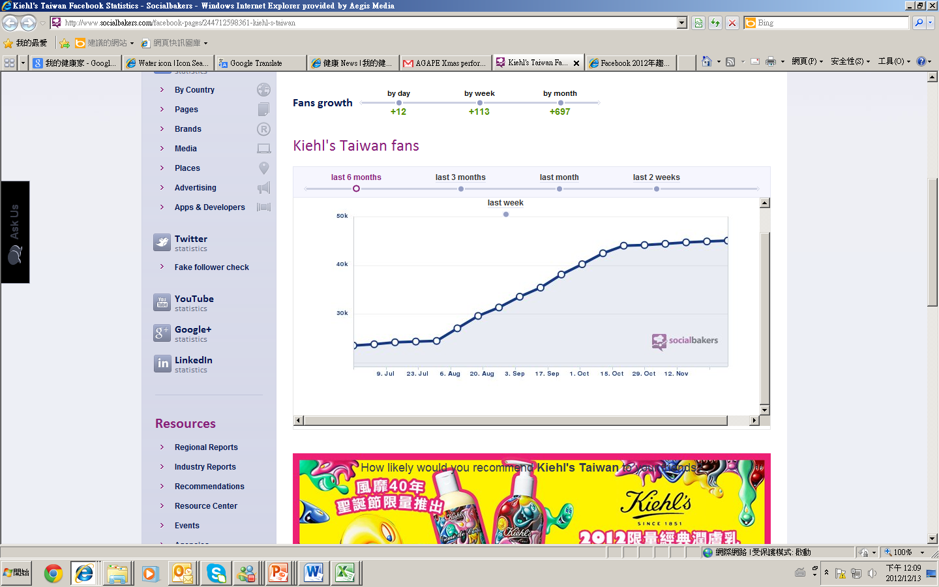
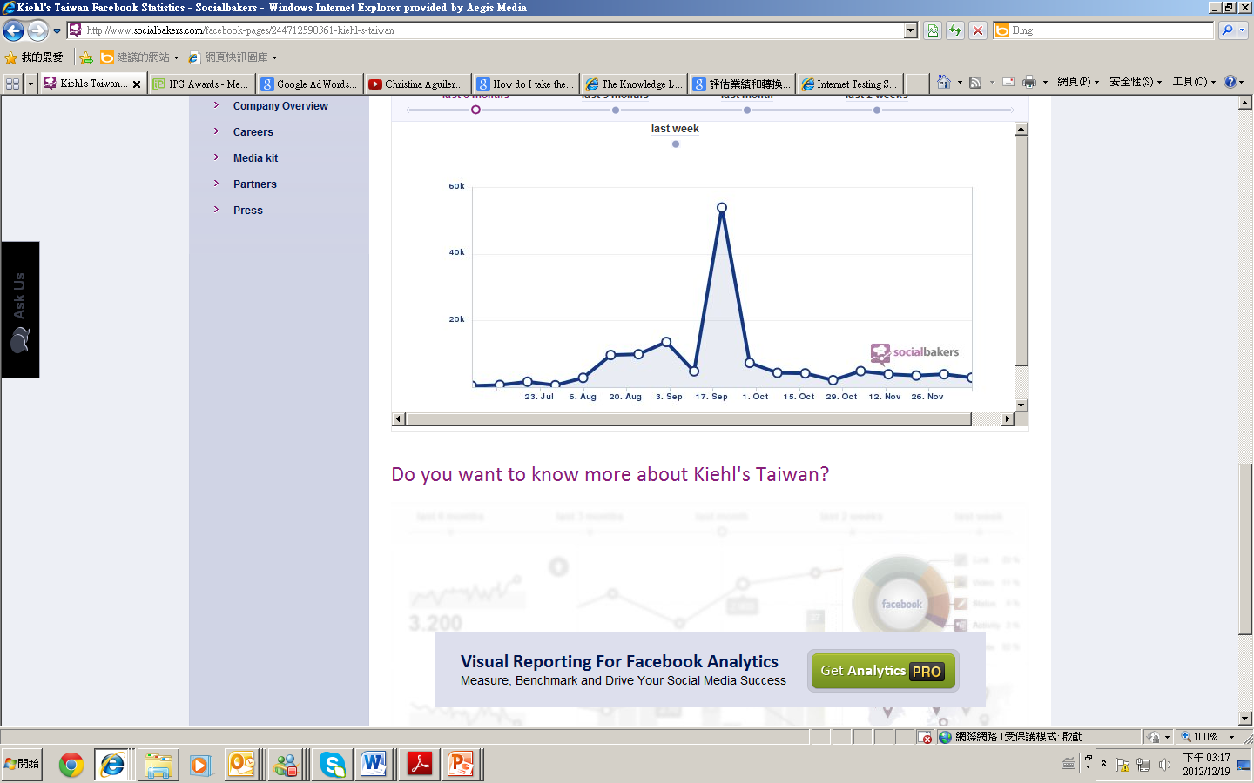
Performance
Within the Campaign period, (September- October), our performance proved our mission was accomplished….
Unit: views
The performance of Kiehl’s YouTube videos dramatically surpassed general videos by over 200%!
200%
251%
292%
Kiehls Facebook Fans
People are talking about
Facebook fans started to increase dramatically in September and exceeded 45k in October
The number reached climax (almost 60K) in September!

